Slide 1

Motion Planning
Part one : Outline
Part two : BFS DFS
Part three : Groups and Researchers

Slide 2
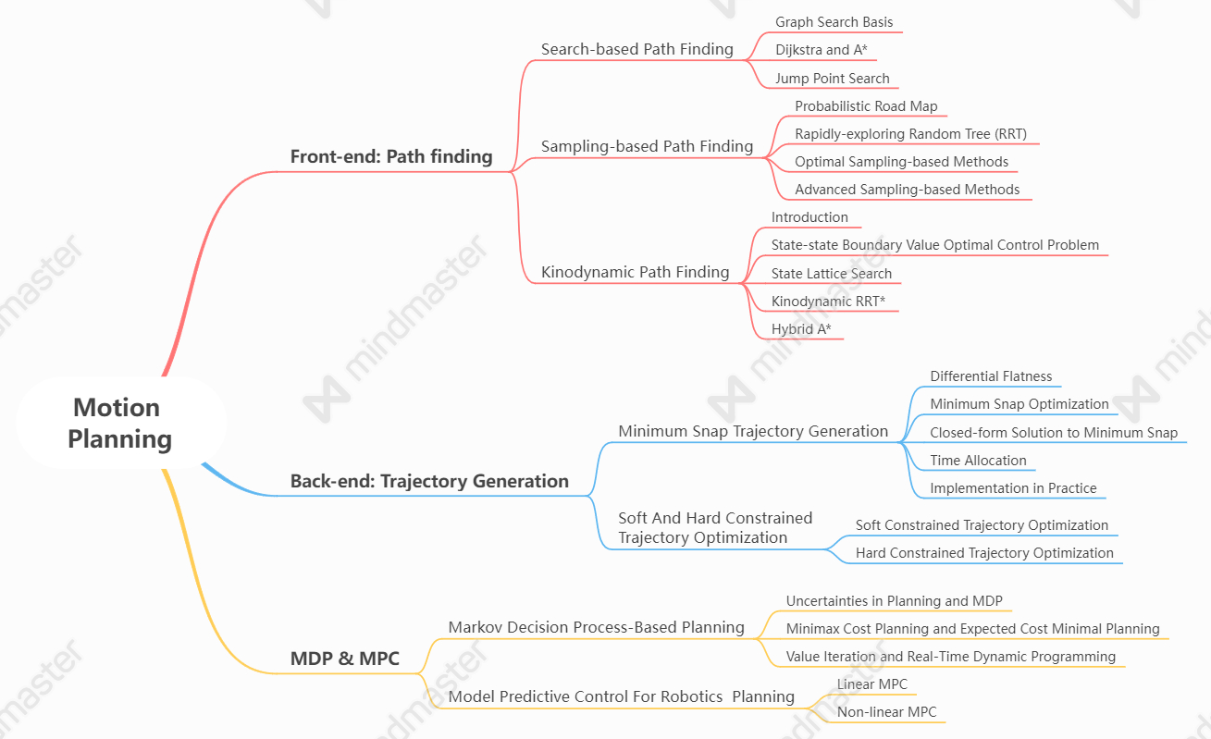
Part one: Outline

Slide 3
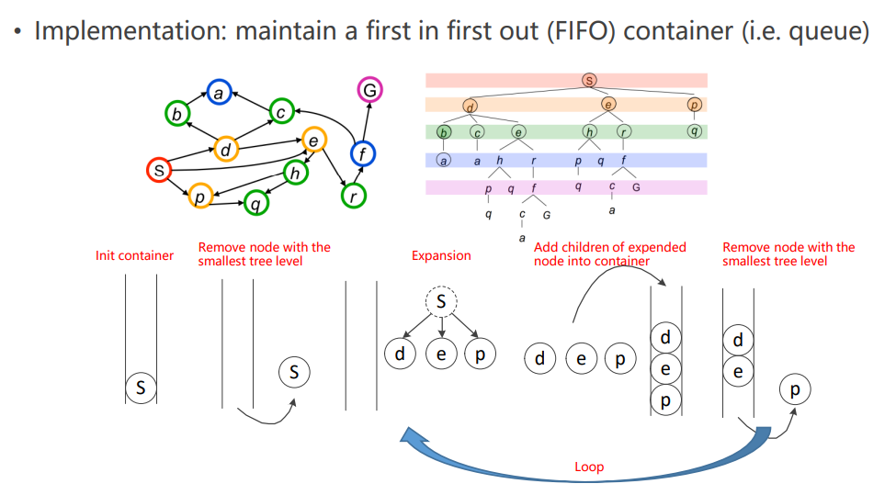
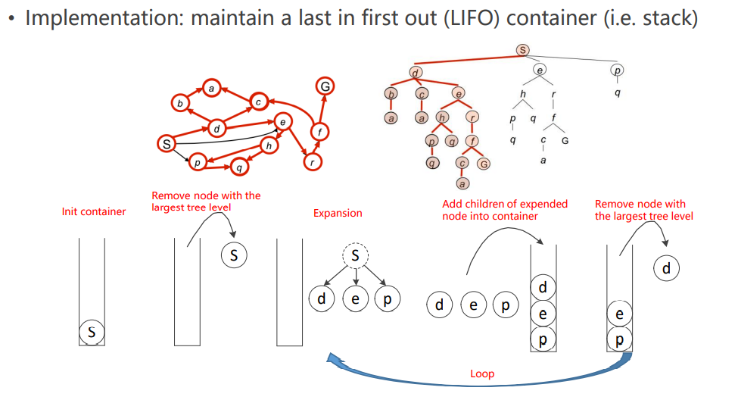
Part two: Breadth First Search (BFS)
Depth First Search (DFS)

Slide 4
Part three: Groups and Researchers
Massachusetts Institute of Technology
• Jonathan How
Research Interests: modelling, control, planning
Homepage: www.mit.edu/~jhow
• Nicholas Roy
Research Interests: perception, learning
Homepage: http://groups.csail.mit.edu/rrg/
ETH Zurich
• ASL Team, Roland Siegwart
Research Interests: perception, control
Homepage: https://asl.ethz.ch/
• Raffaello D’Andrea
Research Interests : control, swarm
Homepage: https://raffaello.name/
Carnegie Mellon University
• Nathan Michael
Research Interests: planning
Homepage: www.rislab.org
• Sebastian Scherer
Research Interests: perception, planning
Homepage: http://theairlab.org/
University of Pennsylvania
• GRASP Lab,Vijay Kumar
Research Interests: planning, control, swarm
Homepage: www.kumarrobotics.org
University of Oulu
• Steven M. LaValle
Research Interests: planning, control
Homepage: http://lavalle.pl/

Slide 5
Thanks for Listening！

